Slide 1

S.K.Y RECORDS
PRESENTS
ao
青
LODISHEN NARAYANASAWMY
NANA BOATENG
NEIL MAGAMBO

Slide 2


02
S.K.Y RECORDS
WHAT IS AO?
We’re creating a seamless mobile streaming music platform which hosts high-fidelity audio files and provides an intuitive interface for listeners and creators.

Slide 3
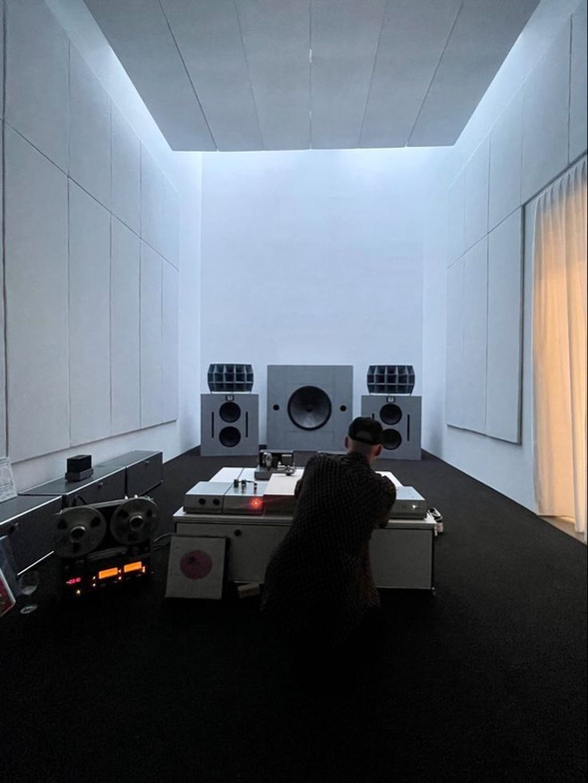
03
AUDIENCE/CUSTOMER
Our audience is the mindful listener, the music enthusiast, maybe even the purist. Our platform facilitates casual listening experiences and is powerful enough to cater to High-Fidelity environments as well.

Slide 4

04
S.K.Y RECORDS
BACKGROUND
S.K.Y Records has noticed an increased interest for music making but with very low accessibility for small artists. Distribution of one’s own music can be very expensive, especially if you do not have your own label,
PROBLEM HISTORY
Many platforms have tried building their own music streaming service but distributing music has been found to be expensive. Music quality while streaming is also low, often clipping and distorting at higher volumes.

Slide 5

05
STUDIO SHODWE
SOLUTION
S.K.Y Records is making music distribution affordable and accessible for small artists by offering low-cost, label-free release options. We help musicians share their work on major streaming platforms without high upfront fees, ensuring they keep more of their earnings. Our platform provides easy distribution, artist support, and marketing resources to help independent artists grow their careers without financial barriers.

Slide 6

06
S.K.Y RECORDS
SUCCESS CRITERIA
Here at SKY Inc., we measure success through customer feedback and by leveraging data tools for accurate insights into customer behavior. Of course, our fist priority is to create a fully functional application with

Slide 7
S.K.Y RECORDS
THANK YOU
LODISHEN NARAYANASAWMY
NANA BOATENG
NEIL MAGAMBO

